Slide 1
Dynamixel motor

Slide 2
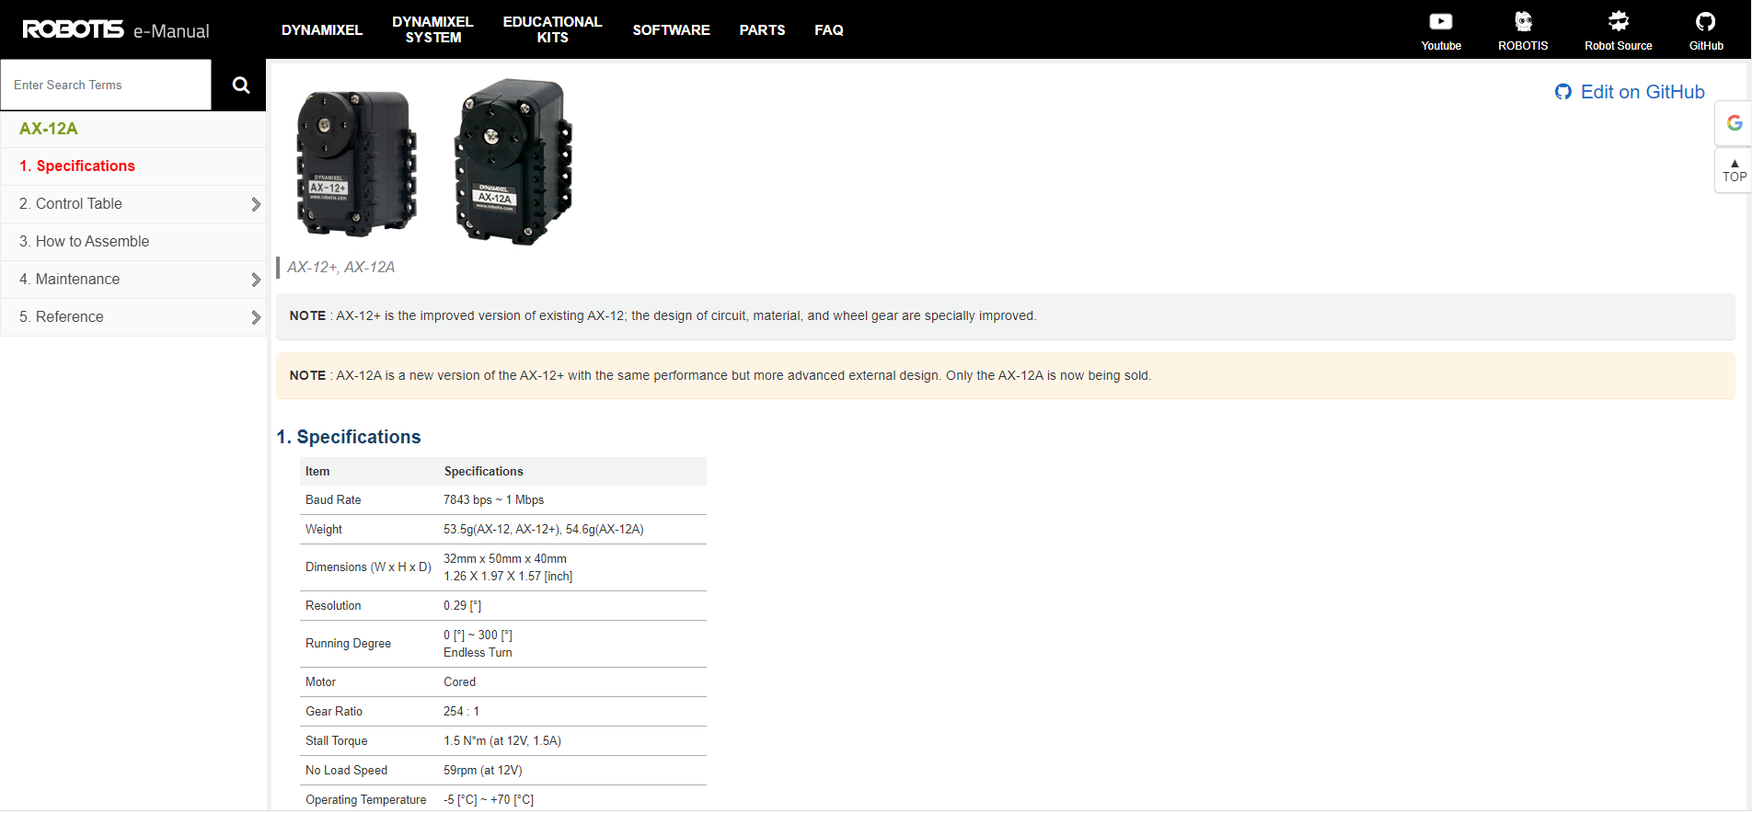
DYNAMIXEL AX-12A manual
https://emanual.robotis.com/docs/en/dxl/ax/ax-12a/#control-table-of-eeprom-area

Slide 3
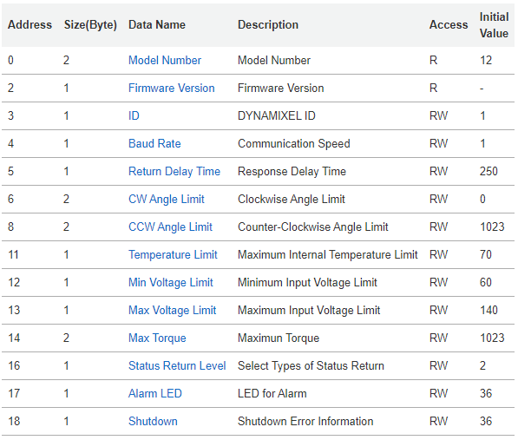
Control Table of EEPROM Area
Data in the EEPROM Area is maintained even when the device is powered off(Non-Volatile).

Slide 4
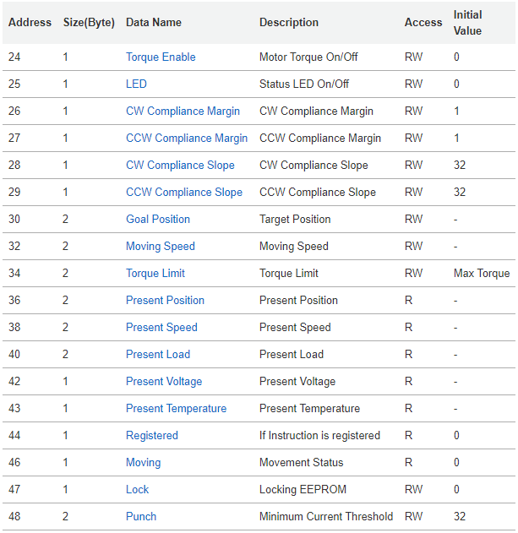
Control Table of RAM Area
Data in the RAM Area is reset to initial values when the power is reset(Volatile).

Slide 5
Detail of Control Table
1. Address : Memory location of function data
2. Size(Byte) : Data occupies number of bytes
3. Access : “RW” property stands for read and write access permission.
“W” stands for write only access permission.
“R” stands for read only access permission.
4. Initial value : Initial Values in the RAM area are restored when the device is turned on. Default values in the EEPROM area are initial values of the device (factory default settings)

Slide 6
Detail of Control Table
Address (Decimal)
33
32
31
30
29
28
27
26
:
:
:
The stack is corresponding to the below Table look like the stack on the right
0x01
0x90
0x02
0x00
0x20
0x20
0x01
0x01
:
:
:
Data Name
Moving Speed(high byte)
Moving Speed(low byte)
Goal Position(high byte)
Goal Position(low byte)
CCW Compliance Slope
CW Compliance Slope
CCW Compliance Margin
CW Compliance Margin
:
:
:

Slide 7
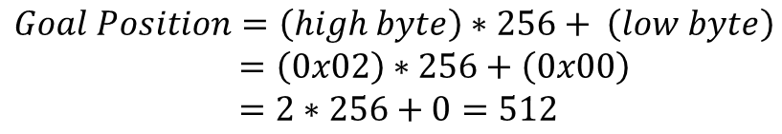
Detail of Control Table
Address (Decimal)
33
32
31
30
29
28
27
26
:
:
:
0x01
0x90
0x02
0x00
0x20
0x20
0x01
0x01
:
:
:
Data Name
Moving Speed(high byte)
Moving Speed(low byte)
Goal Position(high byte)
Goal Position(low byte)
CCW Compliance Slope
CW Compliance Slope
CCW Compliance Margin
CW Compliance Margin
:
:
:
For data larger than 2 bytes will be saved according to Little Endian.
Goal Position occupies 2 bytes consists of low byte and high byte, so value of goal position is equal to below equation.
$$Goal Position=\left(high byte\right)∗256+ \left(low byte\right)$$
$$=\left(0x02\right)∗256+\left(0x00\right)$$
$$=2∗256+0=512$$

Slide 8
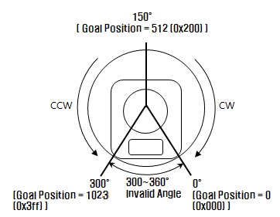
Goal Position and Moving Speed
Goal Position : The available position range is 0 to 1,023 (0x3FF) and the per unit value is 0.29 °
Moving Speed : 0 ~ 1,023(0x3FF) can be used, and the unit is about 0.111rpm.

Slide 9

Instruction Packet
Instruction Packet is the command data sent to the Device.
Header
The field indicates the start of the Packet.
Packet ID
The field that indicates the ID of the Device that should receive the Instruction Packet and process it
Range : 0 ~ 253 (0x00 ~ 0xFD), which is a total of 254 numbers that can be used.
Broadcast ID : 254 (0xFE), which makes all connected devices execute the Instruction Packet.
Length
The field indicates the Byte size of the Instruction, Parameter and Checksum field.
Length = number of Parameters + 2

Slide 10
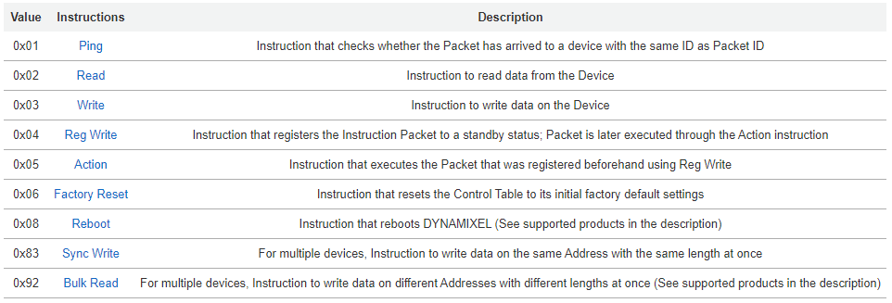
Instruction Packet
Instruction
The field that defines the type of instruction.

Slide 11
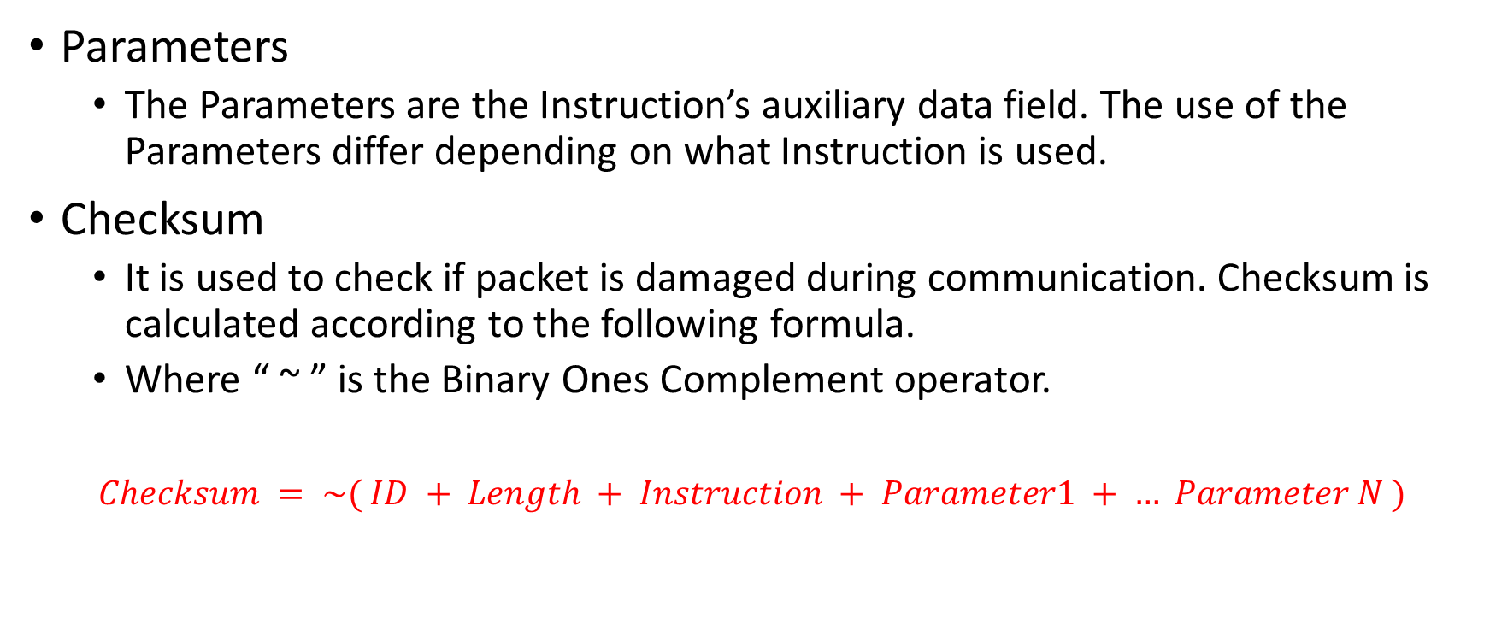
Instruction Packet
Parameters
The Parameters are the Instruction’s auxiliary data field. The use of the Parameters differ depending on what Instruction is used.
Checksum
It is used to check if packet is damaged during communication. Checksum is calculated according to the following formula.
Where “ ~ ” is the Binary Ones Complement operator.
$$Checksum = \sim ( ID + Length + Instruction + Parameter1 + … Parameter N )$$

Slide 12

Instruction Packet
Write
This instruction is to write data to the Control Table of DYNAMIXEL
Parameter1 is starting address.
Parameter2, Pararmeter3, ……, PatameterN are written in order from the starting address.

Slide 13
Instruction Packet
For example, when you want to control goal position of ID1 motor
{ 0xff , 0xff , 0x01 , 0x05 , 0x03 , 0x1e , 0xf4 , 0x01 , 0xe3 }
Parametor1 = 0x1e(Hex) = 30(Dec) = goal position location
Motor ID
Header1
Instruction = 0x03 (write mod)
Header2
Length = number of Parameters + 2

Slide 14
Instruction Packet
For example, when you want to control goal position of ID1 motor
{ 0xff , 0xff , 0x01 , 0x05 , 0x03 , 0x1e , 0xf4 , 0x01 , 0xe3 }
Parameter2 = set up address 30 of memory = low byte of goal position
Parameter3 = set up address 31 of memory = high byte of goal position
Address (Decimal)
33
32
31
30
0x01
0x90
0x01
0xf4
Data Name
Moving Speed(high byte)
Moving Speed(low byte)
Goal Position(high byte)
Goal Position(low byte)
Set goal position value to 500
Low byte = 500 % 256 = 244(Dec) = 0xf4(Hex)
High byte = 500 / 256 = 1(Dec) = 0x01(Hex)

Slide 15
Instruction Packet
For example, when you want to control goal position of ID1 motor
{ 0xff , 0xff , 0x01 , 0x05 , 0x03 , 0x1e , 0xf4 , 0x01 , 0xe3 }
$$Checksum = \sim \left( ID + Length + Instruction + Parameter1 + … Parameter N \right)$$
$$=\sim \left(0x01+0x05+0x03+0x1e+0xf4+0x01\right)=0xe3$$

Slide 16
Arduino

Slide 17

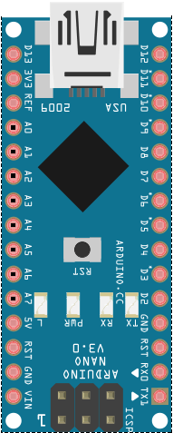
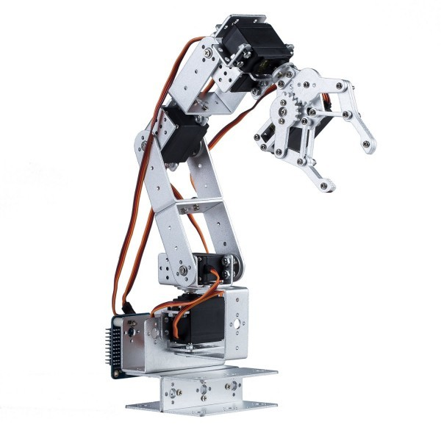
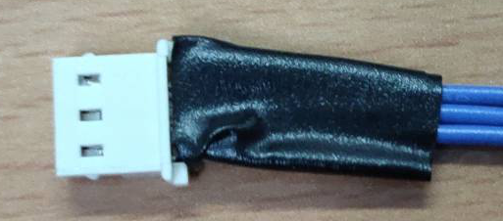
Wiring diagram
D8
GND
12V (no connet)
GND
DATA
Caution : Don’t connet 12V wire to NANO board !!!!!!!!

Slide 18
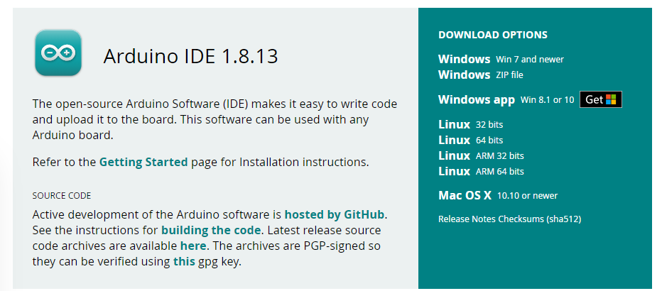
Arduino IDE download
Download website : https://www.arduino.cc/en/software

Slide 19
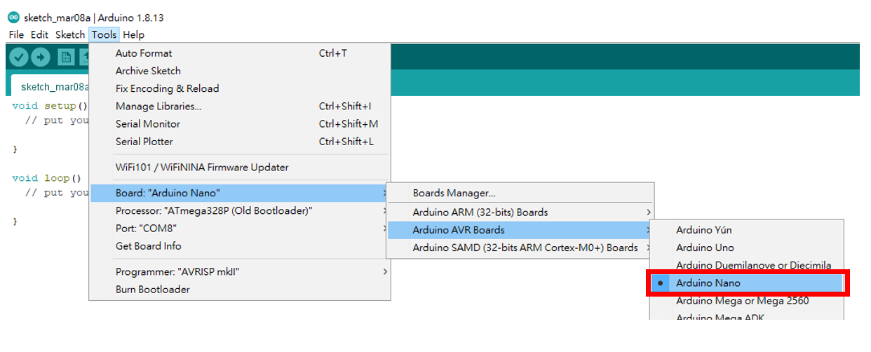
Arduino Setting

Slide 20
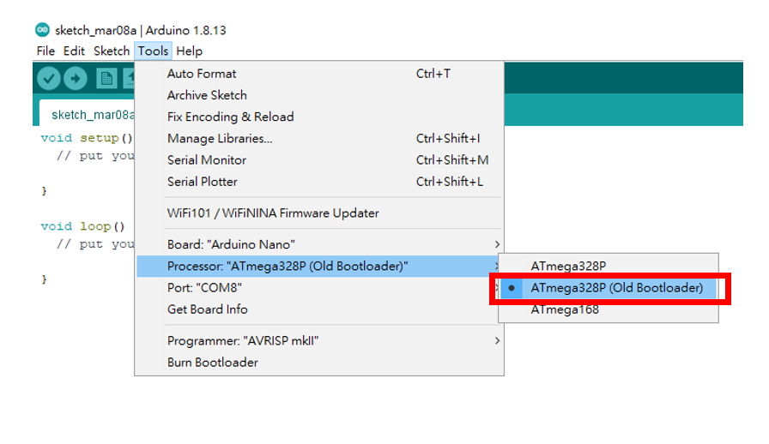
Arduino Setting

Slide 21
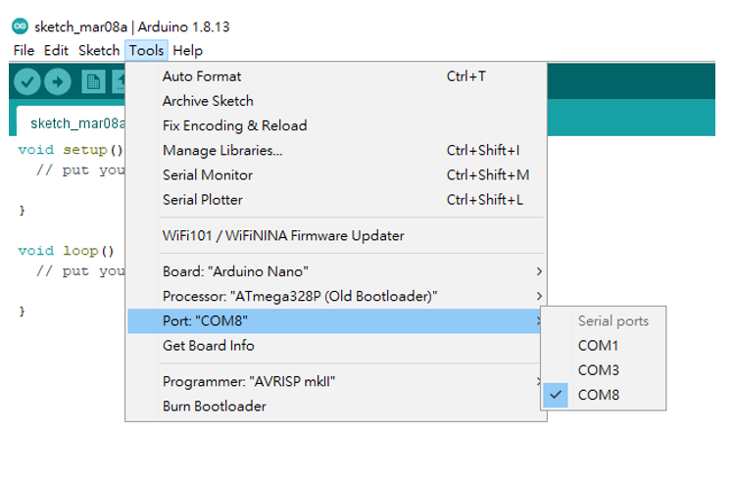
Arduino Setting
The COM number of each computer is different.

Slide 22
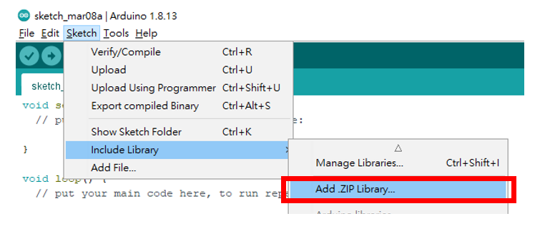
Add .ZIP Library

Slide 23
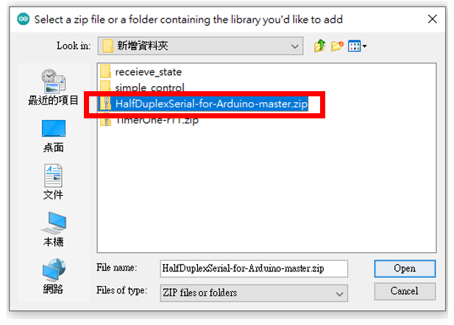
Add .ZIP Library
Select HalfDuplexSerial-for-Arduino-master.zip

Slide 24
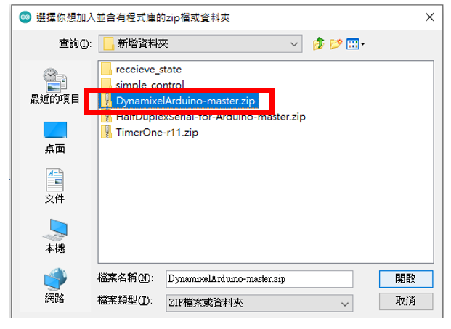
Add .ZIP Library
Select DynamixelArduino-master.zip

Slide 25
Example Code
packet_tutorial
simple_control
read_state

Slide 26
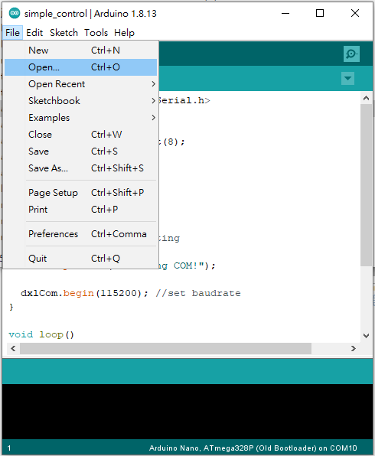
Open example code

Slide 27
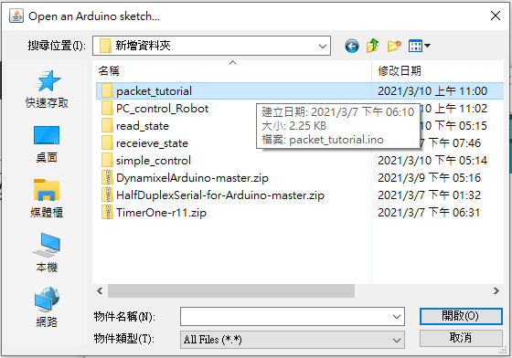
Open example code
Select one that you want to open.

Slide 28

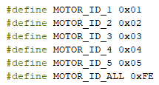
packet_tutorial
Include the SoftHalfDuplexSerial library.
Set SoftHalfDuplexSerial pin number
Define the motor ID. When motor ID changes, you just only modify this section.

Slide 29
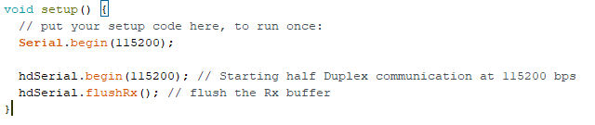
packet_tutorial
Function setup() only execute once, when the NANO device turned on.
Set the serial baudrate 115200 bit/s.

Slide 30
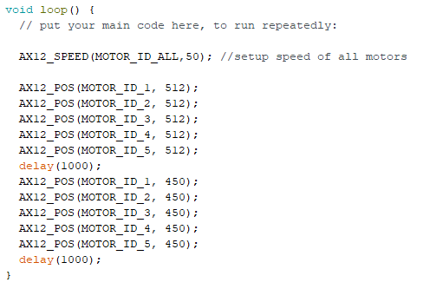
packet_tutorial
Function loop() always execute repeatedly, when the NANO device turned on.
Call AX12_SPEED function to change the motor speed
Call AX12_POS function to change the motor position

Slide 31
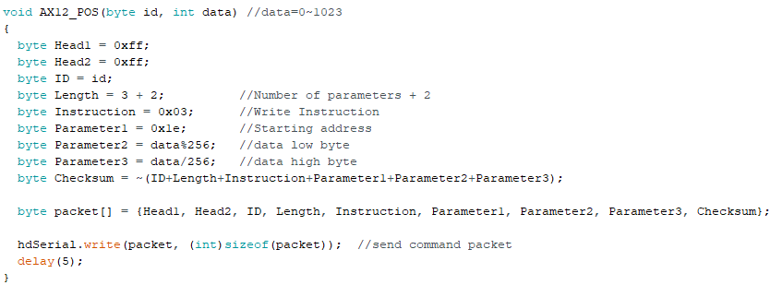
packet_tutorial
Define AX12_POS function
Divide the data into low byte and high byte.
Send the packet to motor through the soft half duplex pin.

Slide 32
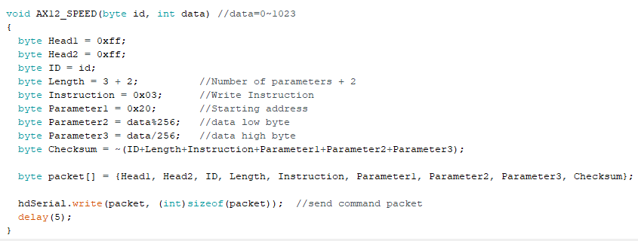
packet_tutorial
Define AX12_SPEED function
Divide the data into low byte and high byte.
Send the packet to motor through the soft half duplex pin.

Slide 33
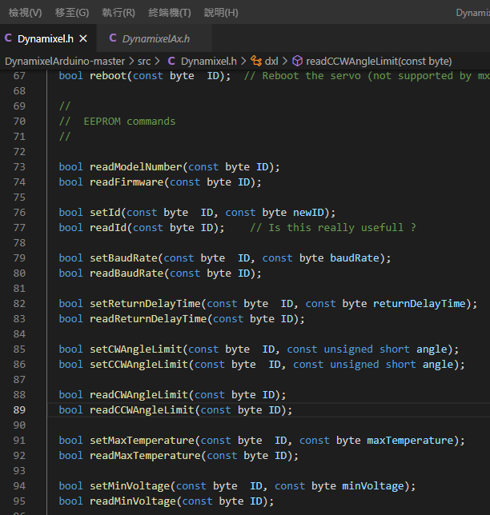
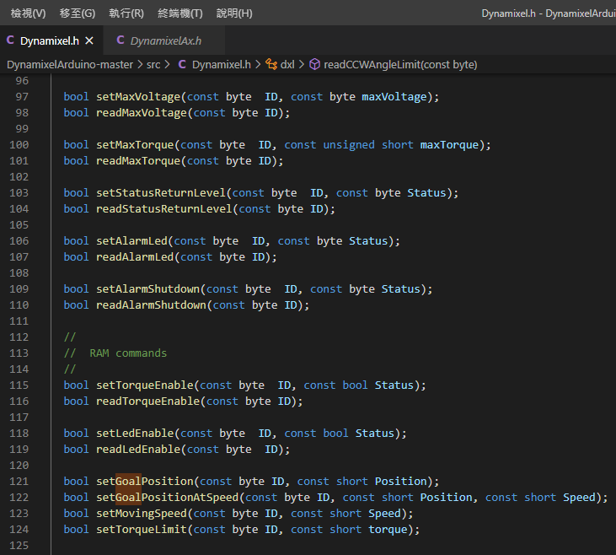
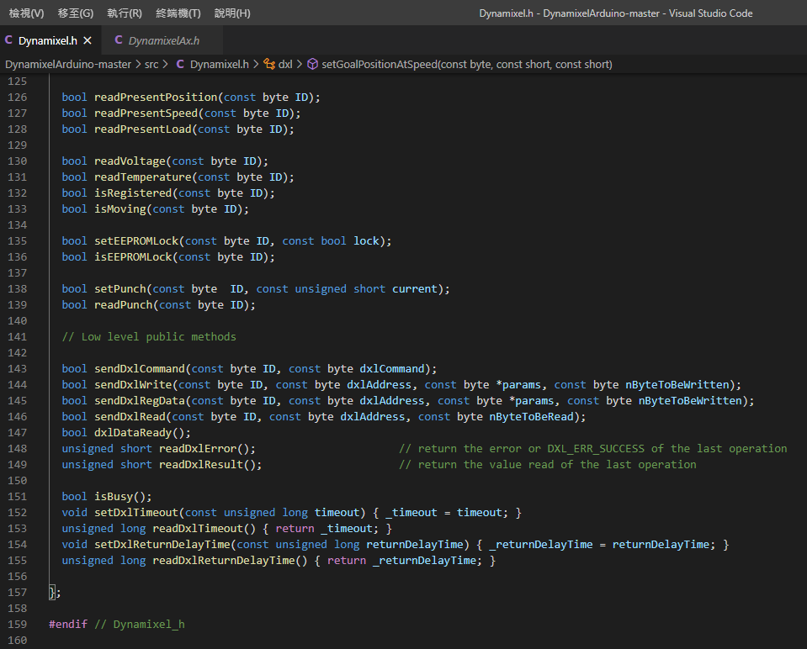
Use DynamixelArduino library
You can open the library folder and file, See what functions are provided.

Slide 34


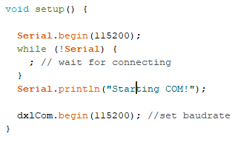
simple_control
Include library.
Set SoftHalfDuplexSerial pin number
Set the serial and the SoftHalfDuplexSerial baudrate 115200 bit/s.

Slide 35
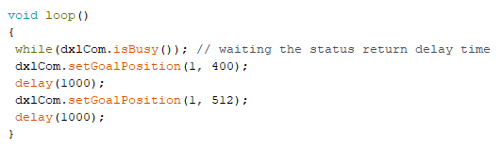
simple_control
while(dx1Com.isBusy()) is in order to wait for free state.
Call setGoalPosition function to change the motor position

Slide 36
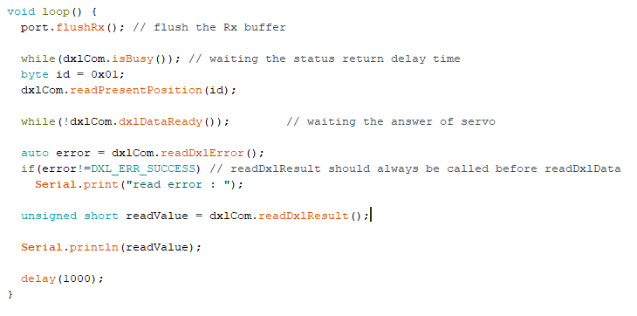
read_state
After calling readPresentPosition function to send read position command to the motor, waiting the data ready and calling readDxlResult to read the data what you want to get.

Slide 37
read_state
If it read error, will print error message.

Slide 38
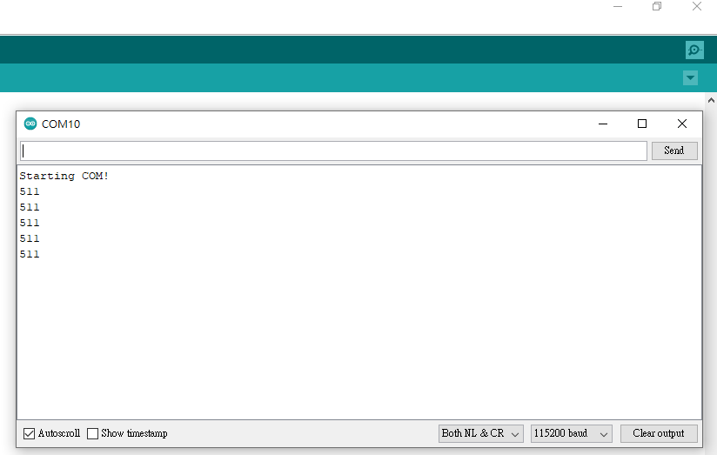
Open Serial terminal

